Slide 1
CAPSTONE PROJECT — PHASE II — KING'S OWN INSTITUTE
EDAPT v2
Educational Data Analytics & Predictive Tool — a role-based analytics platform that turns disconnected CSV extracts into early, explainable warnings about student risk.
Prepared By:
Griffins Leshan
Gyani Bohara
Koshish Shrestha
Nitesh Bhatta
Preeti Khatri
Sangam Ghale Gurung

Slide 2
RUNNING ORDER
Presenter: Nitesh Bhatta
What we'll cover, and where it lives in the report
§1–2
The problem, who it's for, and what it's required to do
§6–7
How we tested it, and what we actually found
§3–4
Architecture, system design and the database
§8–9
Ethics, fairness and security — including what's still open
§5
The tech stack, the two models, and the build timeline
§11–12
Benefits to KOI, what's next, and a live walkthrough
Foundations
Overview
02 / 26

Slide 3
BEFORE EDAPT · PROBLEM STATEMENT
Presenter: Nitesh Bhatta
Academic risk was found by accident, not by design
1
Assessment & attendance data sat in CSV dumps too large to read by hand
1
Manual aggregation carried a real risk of human error
2
Risk was flagged only after a staff member happened to notice
2
Nothing predicted an outcome before it had already happened
3
No standard way to compare subjects, cohorts, or terms
3
No channel to act on a flagged student directly
Foundations
§1.3
03 / 26

Slide 4
THE AIM ·
Presenter: Nitesh Bhatta
Build a system KOI can trust to say WHY — not just who's at risk.
Descriptive and predictive analytics, evaluated to a technically and ethically defensible standard — not a black box, and not a single reported accuracy figure.

Slide 5
WHO IT'S BUILT FOR · STAKEHOLDERS
Presenter: Gyani Bohara
Three roles, three scopes of data
●●
SUBJECT-SCOPED
●●
INSTITUTION-WIDE
●●
FULL ADMIN
Lecturer
Head of School
Head of Technology
Dashboards, predictions and at-risk students for the subjects they actually teach.
Academic analytics and shared admin across data ingestion, model health and AI configuration.
Everything above, plus the audit log, user management and the API console.
Foundations
§1.6
05 / 26

Slide 6
WHAT THE SYSTEM MUST DO · FUNCTIONAL REQUIREMENTS
Presenter: Gyani Bohara
Nine capabilities, from login to audit trail
✓
Authentication
✓
Data ingestion
✓
Descriptive analysis
Role-based access control at every endpoint.
Accepts institutional CSV extracts, validating column structure on the way in.
Institution-wide analytics, filterable by year, subject and lecturer.
✓
Predictive analysis
✓
Model governance
✓
Intervention tracking
A pass-probability for a given student and subject, from data confirmed available at prediction time.
Every trained model is kept on record; nothing reaches production without human-authorised promotion.
A record of action taken against a flagged student.
✓
AI-assisted functionality
✓
Outgoing communication
✓
Auditability
Gemini, Anthropic or OpenAI, switchable at runtime with no redeploy.
One or more SMTP servers, credentials encrypted at rest.
A permanent trail of key administrative activity.
Foundations
§2.1
06 / 26

Slide 7
HOW IT MUST BEHAVE · NON-FUNCTIONAL REQUIREMENTS
Presenter: Gyani Bohara
Ten quality attributes, each with a stated target
◆
Performance
◆
Auditability
Dashboard loads within 3 seconds for a normal-sized extract.
Every major admin action recorded and traceable.
◆
Model performance
◆
Usability
Fail-class precision/recall as the real criteria; accuracy is only a sanity check.
Usable by academic staff with no SQL or data-analysis background.
◆
Reliability
◆
Maintainability
Fails gracefully on missing data — never a confident, wrong answer.
Modular, documented, with a regression suite run on every change.
◆
Security
◆
Scalability
JWT-authenticated sessions and role-based access on every sensitive endpoint.
Modular architecture — extendable with no redesign.
◆
Privacy
◆
Portability
Masked identifiers throughout — no claim of full anonymisation.
Deployable from source via Docker Compose, dev and prod alike.
Foundations
§2.2
07 / 26

Slide 8
UNDER THE HOOD · SYSTEM ARCHITECTURE
Presenter: Griffins Leshan
Three layers, each replaceable on its own
PRESENTATION
APPLICATION
DATA
React 18 + Recharts
FastAPI · Gunicorn
PostgreSQL 16 + Pandas
Role-scoped SPA; navigation guards for UX, never the security boundary.
Auth, business logic, the ML pipeline, and every external-service call.
Relational store for operations; academic data lives in-memory for speed.
Proven in practice: the AI provider layer went from one hardcoded integration to a runtime-configurable one — with zero changes to the layers on either side.
System & Models
§3
08 / 26

Slide 9
WHAT IT'S ACTUALLY BUILT WITH · §5.2 TECHNOLOGY STACK
Presenter: Griffins Leshan
One stack per layer, nothing exotic
BACKEND
DATABASE
DATA & ML
Python 3.12 · FastAPI
PostgreSQL 16
Pandas · Scikit-Learn
Uvicorn for dev; Gunicorn + Uvicorn workers in production.
SQLAlchemy 2.0 with the async driver asyncpg end to end.
XGBoost models, SMOTE for imbalance, SHAP for explanation, Joblib for serialisation.
FRONTEND
INFRASTRUCTURE
React 18 · Router 6
Docker Compose
Recharts for data, Axios for API calls.
Separate configurations for development and production.
System & Models
§5.2
09 / 26

Slide 10
HOW THE BUILD WAS TRACKED · §5 IMPLEMENTATION TIMELINE
Presenter: Griffins Leshan
A work breakdown structure, checked weekly
Definition
Requirements
Design
Development
Iteration
Deployment
The trimester was tracked against these six phases, with weekly snapshots cross-referenced against the project's own progress log — not a plan made once and forgotten.
System & Models
§5
10 / 26

Slide 11
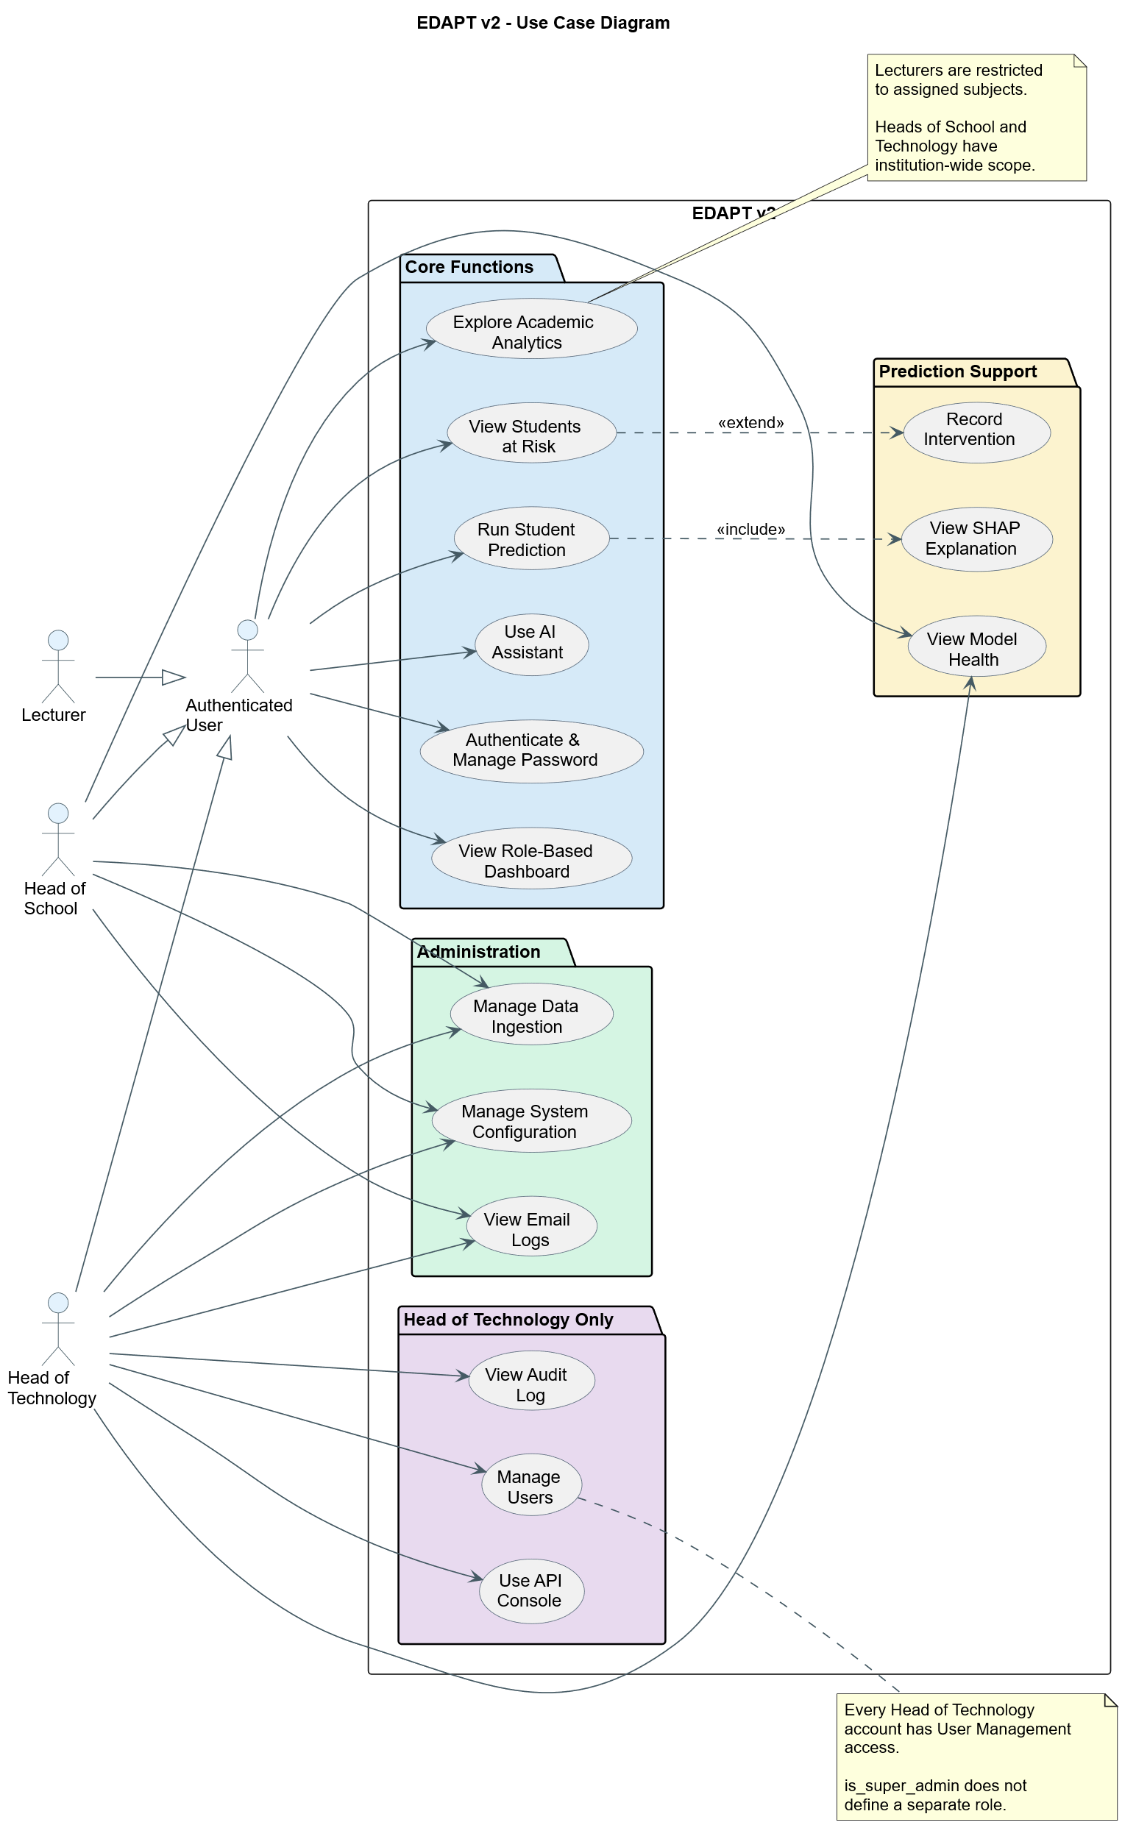
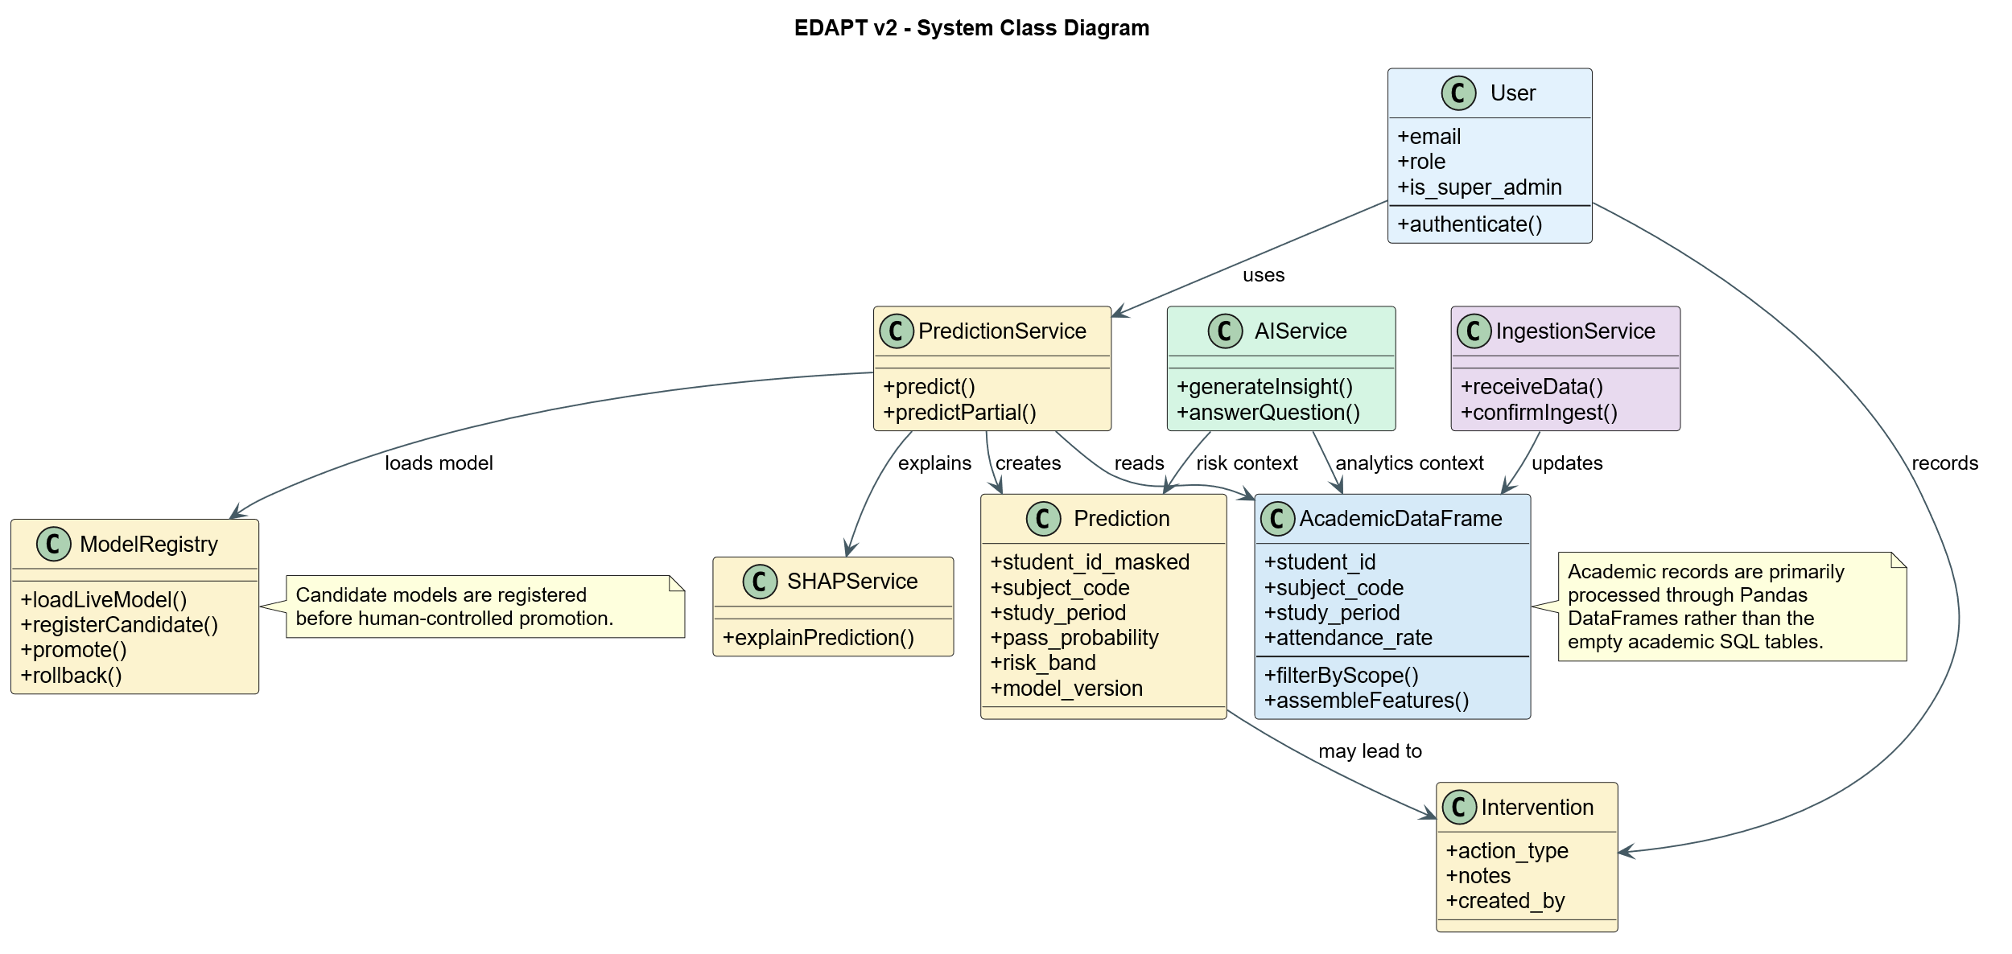
MODELLING IT BEFORE BUILDING IT · SYSTEM DESIGN
Presenter: Griffins Leshan
Three roles, one set of classes, mapped before a line of code
Fig. 2 — Use Case Diagram
Fig. 3 — System Class Diagram
System & Models
§4.1–4.2
11 / 26

Slide 12
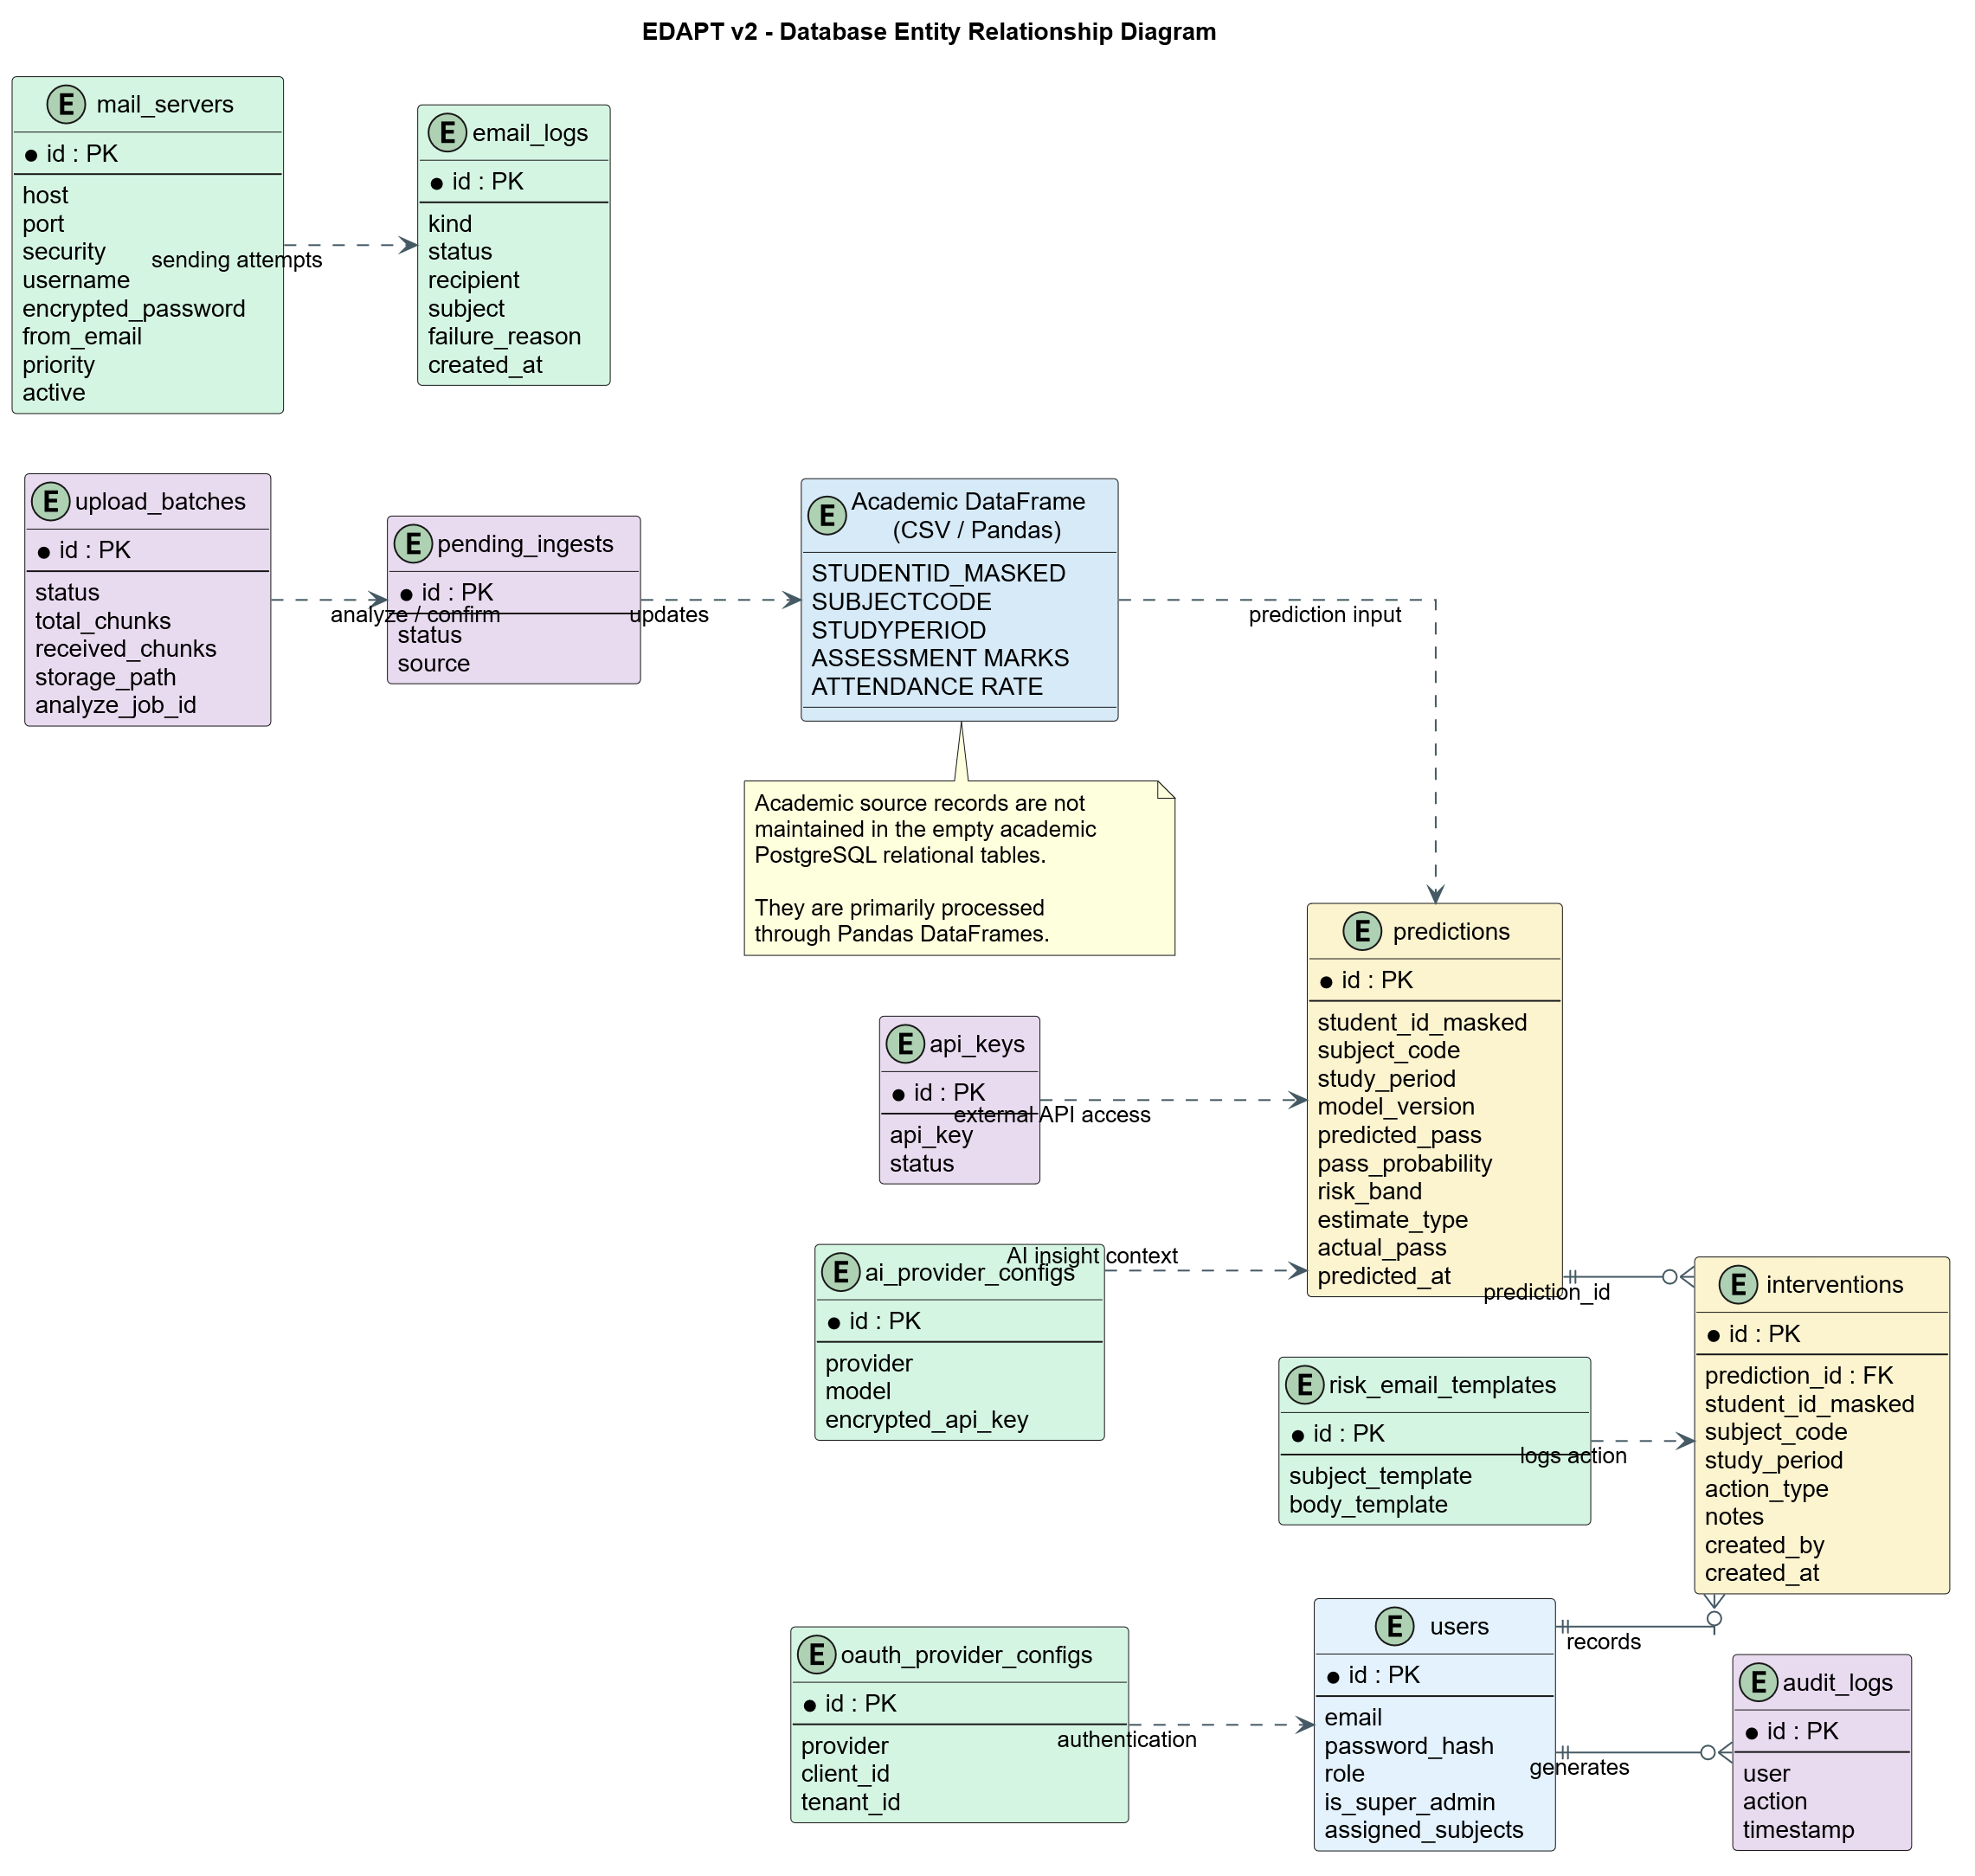
WHAT'S ACTUALLY IN POSTGRES · DATABASE DESIGN
Presenter: Griffins Leshan
Operations and governance are relational — academic data isn't
What lives where
Users, predictions, interventions, audit logs, mail servers and AI provider configs live here.
Academic source records don't — they're processed through Pandas DataFrames, not maintained as empty relational tables.
Fig. 5 — Database ERD
System & Models
§4.4
12 / 26

Slide 13
PREDICTIVE ANALYTICS ·
Presenter: Sangam Ghale Gurung
Two models, because a term in progress isn't a finished record
Complete-record model — 65,903 finished enrolments, 124 subjects
Mid-term model — trained on truncated snapshots (illustrative)
Feeding partial data to the complete-record model first hit 100% training accuracy — a textbook sign of leakage, not skill. Hence a second model, trained only on what a mid-term snapshot actually contains.
System & Models
§5.5.1
13 / 26

Slide 14
MODEL PERFORMANCE ·
Presenter: Sangam Ghale Gurung
EDAPTv2 Machine Learning Pipeline
System & Models
§7.4.1
14 / 26

Slide 15
MODEL PERFORMANCE ·
Presenter: Sangam Ghale Gurung
EDAPTv2 Prediction Sequence Diagram
System & Models
§7.4.1
14 / 26

Slide 16
MODEL PERFORMANCE · §7.4.1
Presenter: Sangam Ghale Gurung
95.40% accuracy isn't the number that matters
Passing students outnumber failing ones — accuracy alone would flatter a model that misses the exact students it exists to find. We report the fail-class metrics instead.
Precision
.7931
Recall
.7809
F1
.7869
PR-AUC
.8808
System & Models
§7.4.1
14 / 26

Slide 17
TALKING TO THE OUTSIDE WORLD · §5.8–5.9
Presenter: Nitesh Bhatta
Integrations & the API surface
AI PROVIDERS
✉
OUTGOING MAIL
REST API
Gemini, Anthropic, OpenAI
SMTP + templated email
FastAPI, self-documenting
Configured at runtime through one dispatch function — no redeploy needed.
Credentials encrypted at rest. Every send logged as sent or failed, never falsely delivered.
Every capability is a versioned endpoint with auto-generated OpenAPI docs.
System & Models
§5.8–5.9
15 / 26

Slide 18
MODEL PERFORMANCE ·
Presenter: Nitesh Bhatta
EDAPTv2 AI Assistant Sequence Diagram
System & Models
§7.4.1
14 / 26

Slide 19
MODEL PERFORMANCE ·
Presenter: Nitesh Bhatta
EDAPTv2 Outgoing Email Workflow
System & Models
§7.4.1
14 / 26

Slide 20
MODEL PERFORMANCE ·
Presenter: Nitesh Bhatta
EDAPTv2 Deployment Diagram
System & Models
§7.4.1
14 / 26

Slide 21
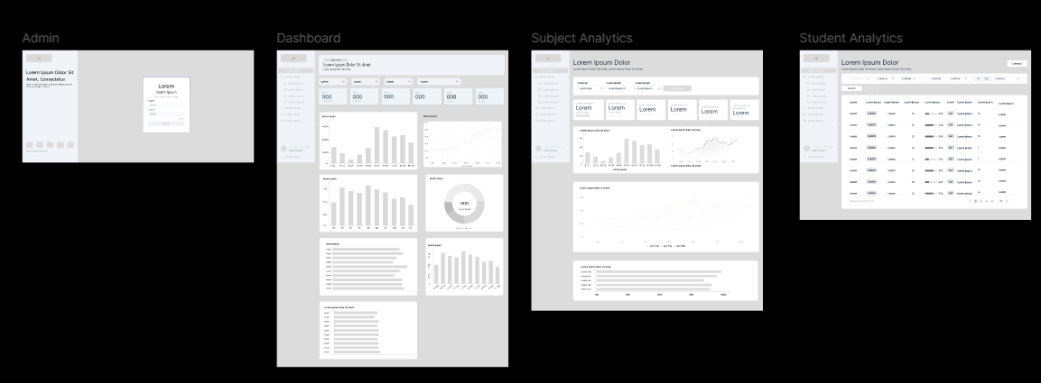
WHAT IT LOOKS LIKE · §4.5.3 T2 REFINEMENTS
Presenter: Koshish Shrestha
Project UI/UX - Wireframe
Explainability & Evaluation
§4.5.3
17 / 26

Slide 22
CHOOSING THE ALGORITHM · §5.5.1 MODEL SELECTION
Presenter: Sangam Ghale Gurung
Two algorithms, chosen to disagree usefully
GRADIENT BOOSTING
BAGGING
XGBoost
Random Forest
Builds hundreds of shallow decision rules in sequence, where each new rule is built specifically to correct the mistakes of the ones before it — good at picking up subtle, non-linear patterns in a student's record.
Builds hundreds of independent decision trees, each trained on a different random slice of the data, then takes a majority vote — good at staying stable and not overreacting to one unusual student.
+
WHY BOTH, NOT JUST ONE — TESTED, NOT ASSUMED
Soft-voting the two together catches 3.5pp more real fail cases
Tested head-to-head against a single XGBoost model: near-identical overall accuracy, but the two-model ensemble correctly identifies 3.5 percentage points more of the students who actually go on to fail — confirmed twice, on two independent time periods. For an early-warning tool, catching more real at-risk students outweighs a small precision trade-off.
Both also guard against the pass/fail class imbalance from two independent angles: SMOTE before training, and Random Forest's own balanced class weighting during it.
System & Models
§5.5.1
—

Slide 23
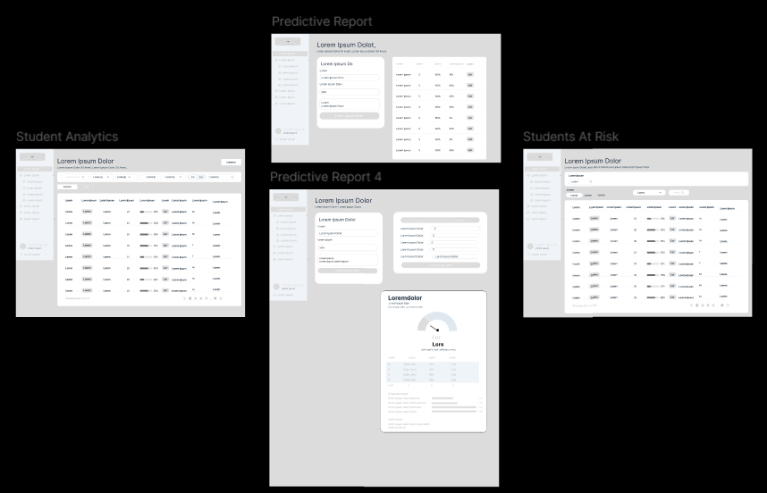
WHAT IT LOOKS LIKE · §4.5.3 T2 REFINEMENTS
Presenter: Koshish Shrestha
Project UI/UX - Wireframe
Explainability & Evaluation
§4.5.3
17 / 26

Slide 24
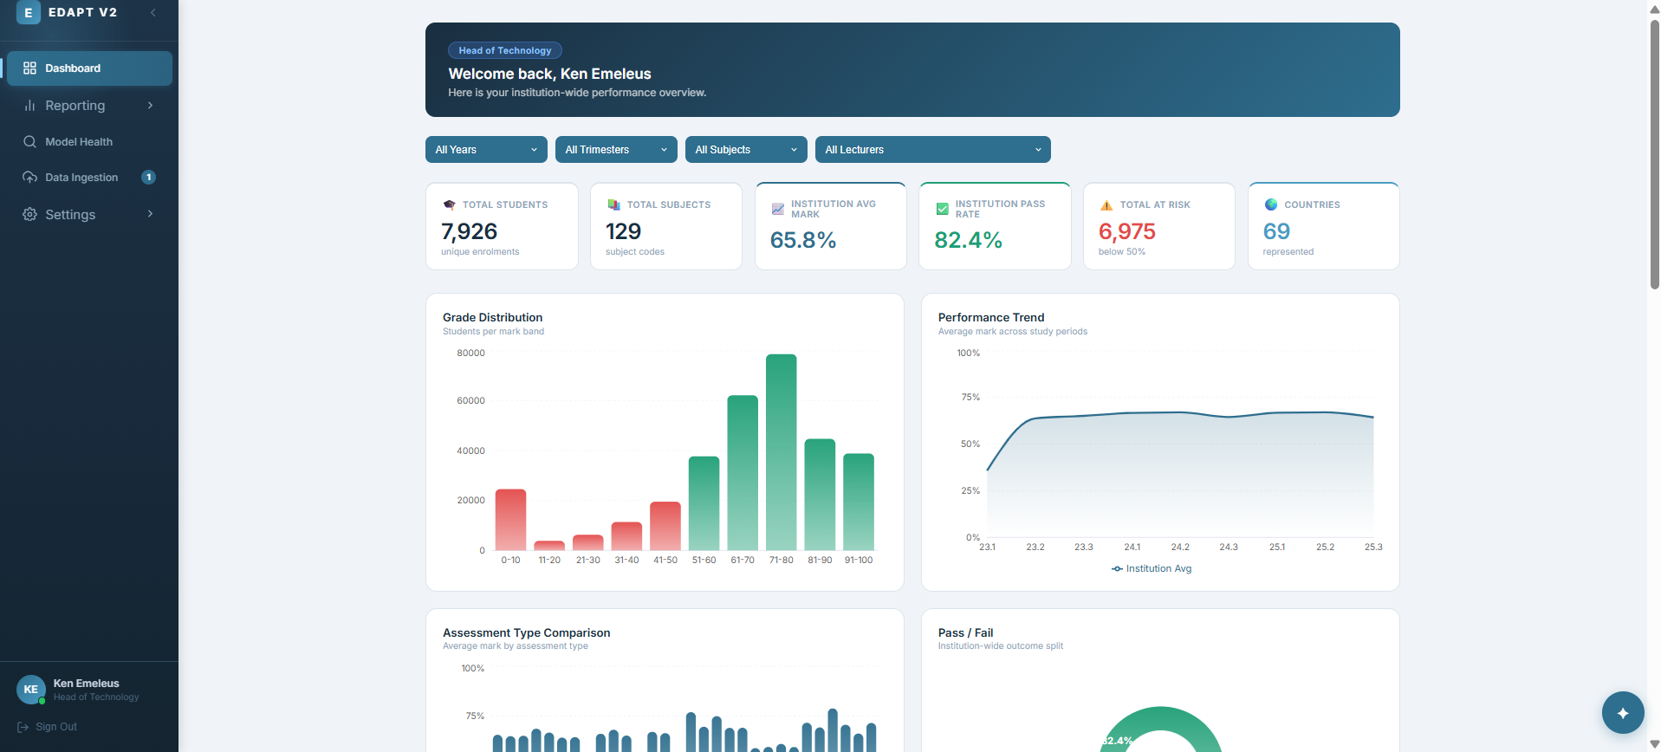
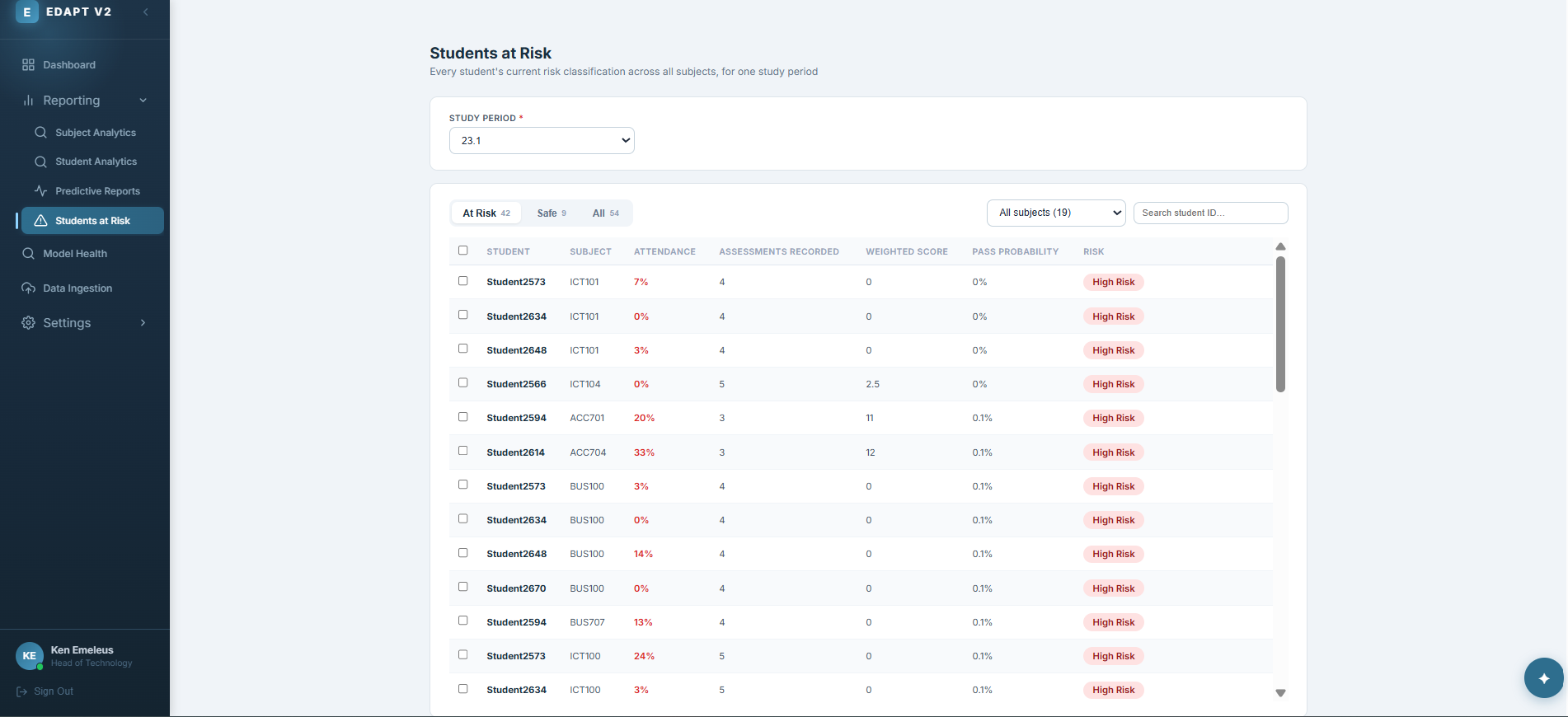
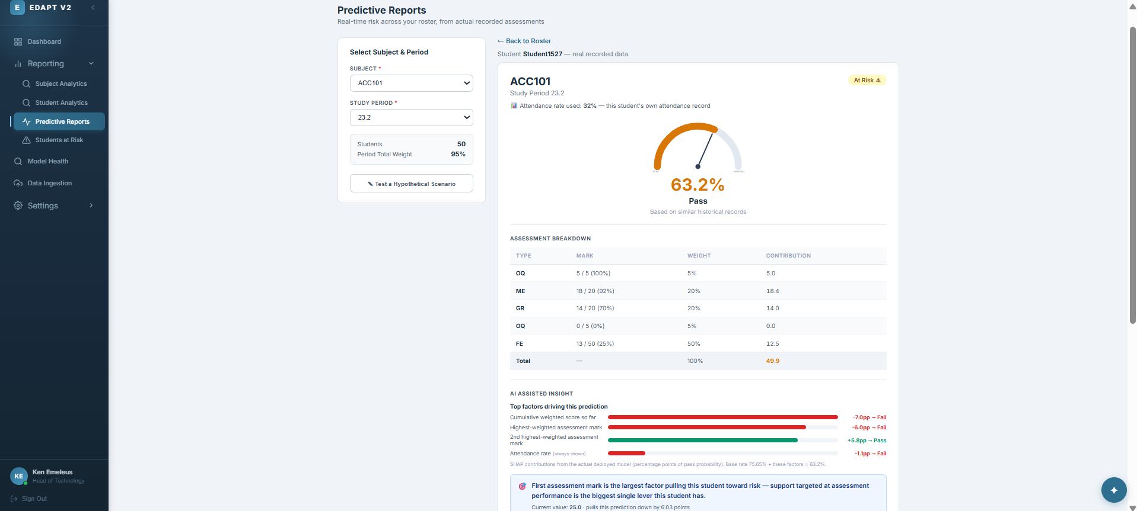
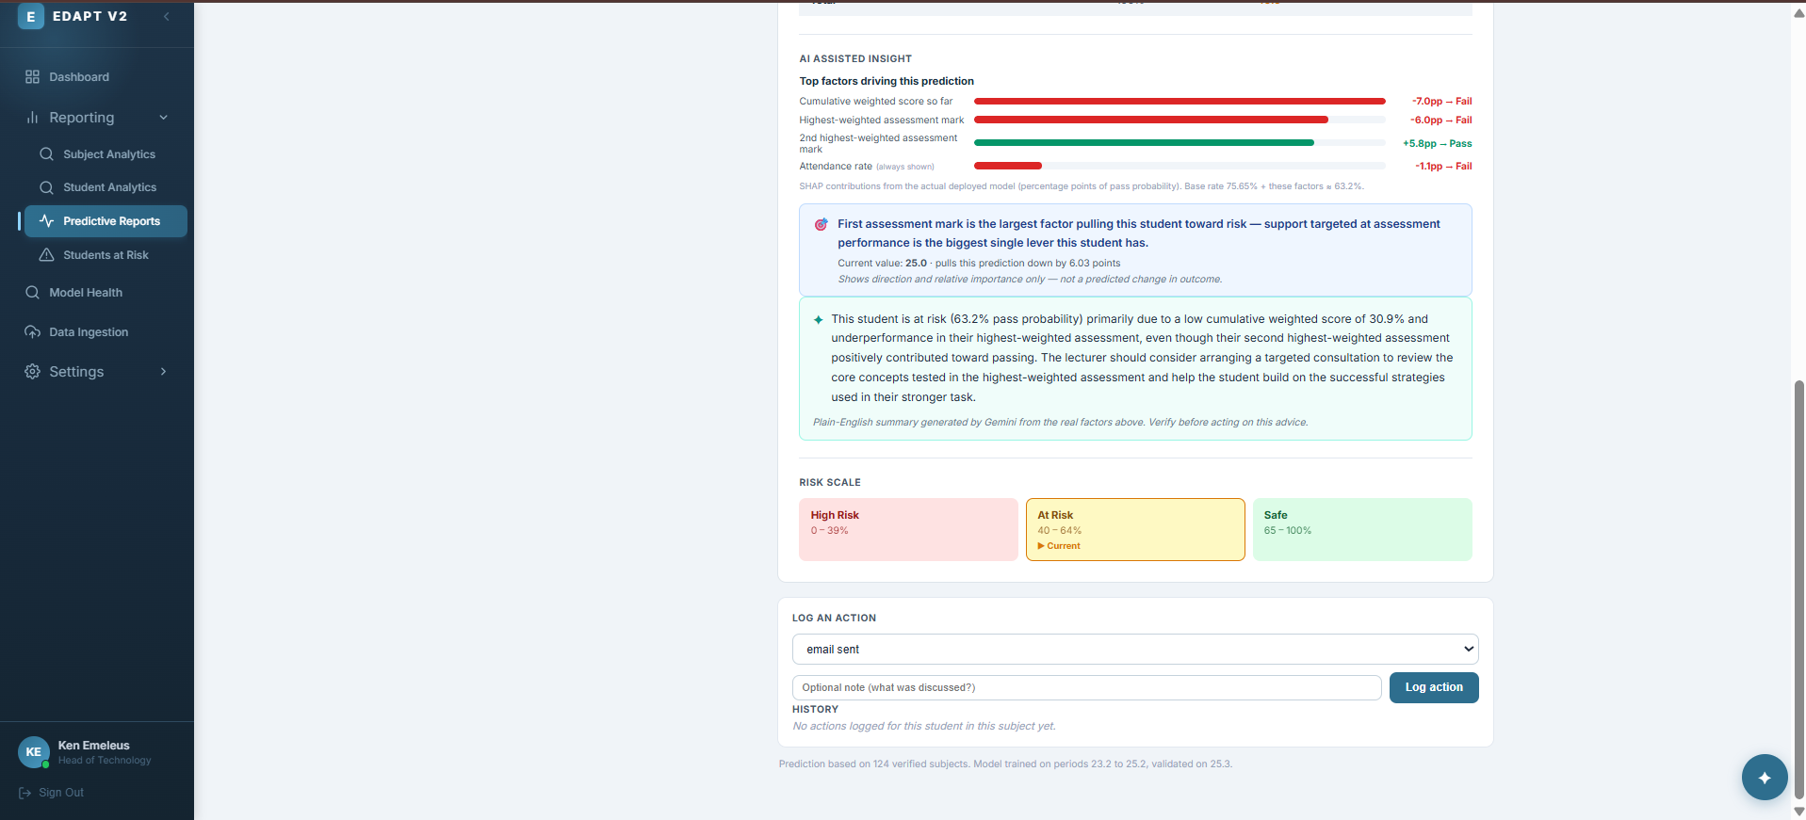
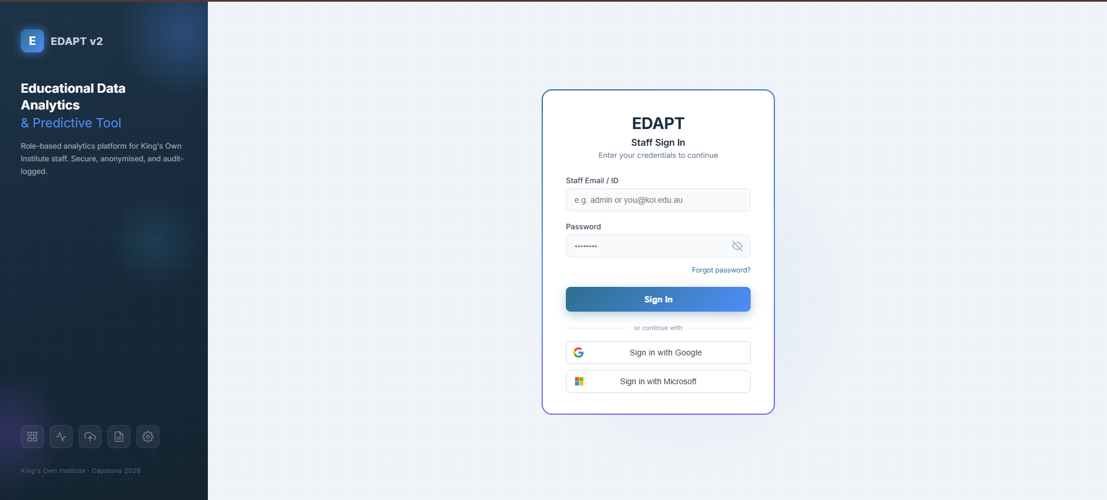
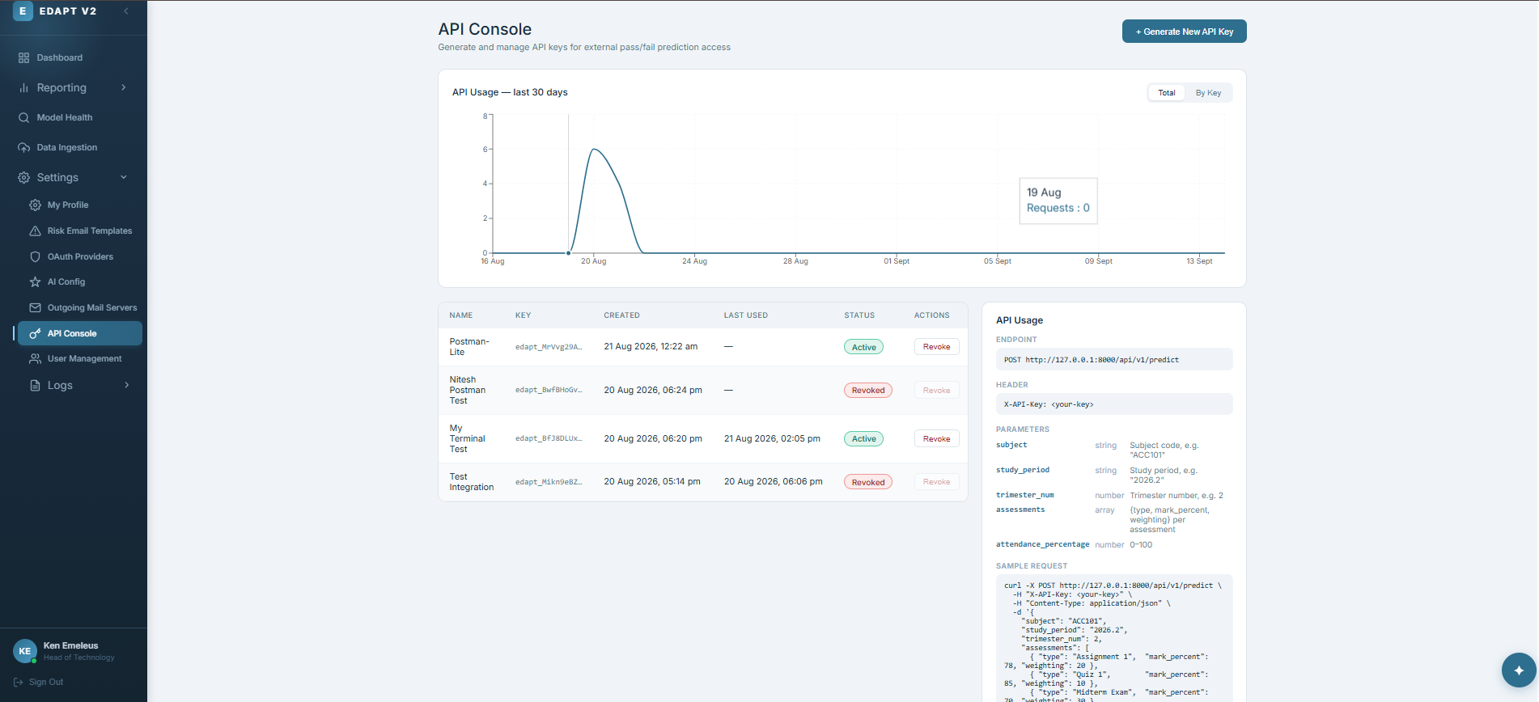
WHAT IT LOOKS LIKE · §4.5.3 T2 REFINEMENTS
Presenter: Koshish Shrestha
Refined against client feedback, not redesigned from scratch
Institution-wide dashboard
Students at-risk analytics
Student-wise predictive report
Student-wise AI insights
Login
API console
Explainability & Evaluation
§4.5.3
17 `

Slide 25
HOW WE TESTED IT · §6 EVALUATION STRATEGY
Presenter: Preety Khatri
Testing to find faults, not to confirm we were right
1
Unit
2
Integration
3
Data verification
4
User acceptance
Validation rules, boundary conditions, SHAP reconstruction.
Frontend -> API -> DB -> background jobs, end to end.
Every dashboard number checked against a real institutional extract.
Walked through with the client, role by role.
Explainability & Evaluation
§6
18 / 26

Slide 26
WHAT WE FOUND · §7.3 KEY DEFECTS
Presenter: Preety Khatri
The evaluation earned its keep
TC-07 — SAME COUNT, TO SCALE
57,710
!
§7.3
Before fix
Passing tests, failing predictions
After fix
7,926
A live prediction outage ran undetected — the suite only ever tested half the serving path.
An “at-risk” count was tallying assessment rows, not students. Fixed to count unique students.
!
TC-03
Deleted, but still signed in
A valid JWT outlived the account it belonged to. Now checked against the database, every request.
Evidence & Rigor
§7.3
19 / 26

Slide 27
DATA PRIVACY ·
Presenter: Preety Khatri
Pseudonymised, and we say so plainly
Students
7,926
Assessment records
327,501
Attendance sessions
2.5M
Shown on a log scale — each row is a different unit (students, then records, then sessions).
Pseudonymised is not anonymised, and we don't claim otherwise — re-identification risk from combined attributes hasn't been ruled out.
Ethics, Fairness & Security
§8.1
21 / 26

Slide 28
CLOSING THE LOOP · §11–12
Presenter: Preety Khatri
Back to the problems we started with
DELIVERED
NEXT
✓
Risk flagged from the start of term, not after a bad grade
→
Direct LMS integration, replacing manual ingestion
✓
Every intervention logged and reviewable over time
→
Counterfactual recommendations — modelled impact, not just a suggestion
✓
Reports drawn live from one dataset — not five spreadsheets
→
Explainability rolled up to cohort and institution level
Impact & Close
§11–12
24 / 26

Slide 29
NOW, LIVE
Live
Let's look at EDAPT v2 itself
1
An institution-wide dashboard, filtered down to one subject
2
A single student's prediction, with its SHAP explanation
3
Logging an intervention against that prediction
4
Switching the AI provider live, from the admin settings
Impact & Close
Live
25 / 26

Slide 30
Thank you.
Questions — about the model, the incident, or anything in between.

